Slide 1
Module 10: vSphere Lifecycle Management

Slide 2
Importance
Managing the life cycle of vSphere involves keeping vCenter Server and ESXi hosts up to date and integrated with other VMware and third-party solutions. To achieve these goals, you must understand how to use the new features provided by vSphere Lifecycle Manager, namely, cluster-level management of ESXi hosts and the vCenter Server Update Planner.

Slide 3
Module Lessons
vCenter Server Update Planner
Overview of vSphere Lifecycle Manager
Working with Baselines
Working with Cluster Images
Managing the Life Cycle of VMware Tools and VM Hardware

Slide 4
Virtual Beans: Lifecycle Management
Virtual Beans is struggling with its current lifecycle management process. The process is mostly manual and is error-prone and inefficient.
The company wants to use vSphere Lifecycle Manager. It hopes that this feature can provide a centralized, automated patch and version management system for keeping vSphere components up to date:
vCenter Server
ESXi hosts
Virtual machines:
VM hardware
VMware Tools
As the vSphere administrator, you must implement vSphere Lifecycle Manager in the Virtual Beans data center.

Slide 5

Lesson 1: vCenter Server Update Planner

Slide 6
Learner Objectives
After completing this lesson, you should be able to meet the following objectives:
Describe features of the vCenter Server Update Planner
Run vCenter Server upgrade prechecks and interoperability reports
Export prechecks and interoperability report results

Slide 7
Overview of vCenter Server Update Planner
In vSphere 7, you can use the Update Planner feature for planning updates to vCenter Server and other VMware products that are registered with it.
The Update Planner can perform the following tasks:
Retrieve information about VMware products registered with vCenter Server.
List available vCenter Server updates and upgrades.
Create interoperability reports.
Perform a precheck to verify that your system meets the minimum software and hardware requirements for a successful upgrade of vCenter Server.

Slide 8
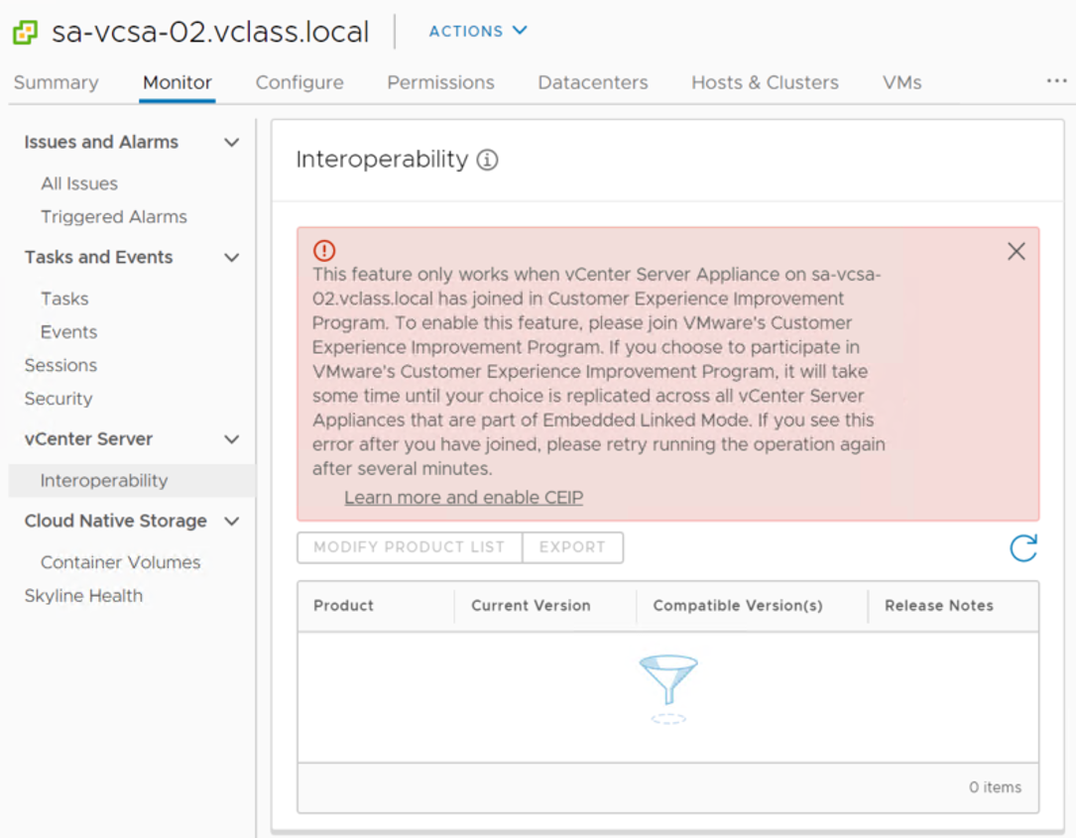
Update Planner Requirements
The Update Planner feature is available for vCenter Server 7.0 or later.
You must join the VMware Customer Experience Improvement Program (CEIP) to generate an interoperability or precheck report.
Notes:
When generating reports, if the Customer Experience Improvement Program (CEIP) is not yet accepted, a prompt describing CEIP appears. Reports are not generated if you do not join CEIP.

Slide 9
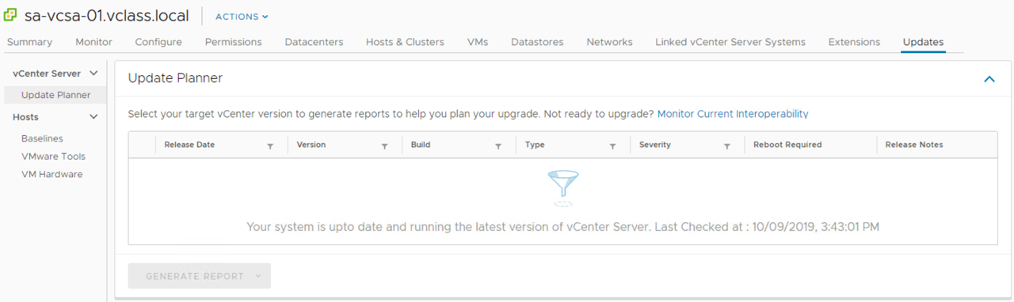
Update Planner View in the vSphere Client
When a new vCenter Server version is available, the new version appears on the Updates tab of the vSphere Client.
Notes:
When new vCenter Server updates are released, the vSphere Client shows a notification in the Summary tab. Clicking the notification directs you to the Updates tab.
The Updates tab has an Update Planner page. This page shows a list of vCenter Server versions that you can select.
Details include release date, version, build, and other information about each vCenter Server version available.
The Type column tells you if the release item is an update, an upgrade, or a patch.
If multiple versions appear, the recommended version is preselected.
After selecting a vCenter Server version from the list, you can generate product interoperability reports and preupdate reports.

Slide 10
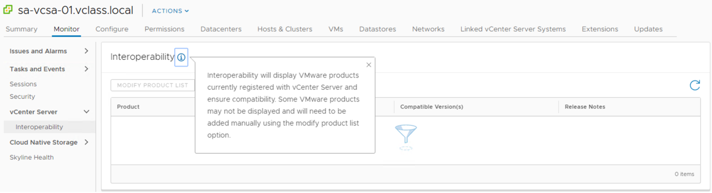
Interoperability View in vSphere Client
The Interoperability page on the Monitor tab shows VMware products that are currently registered with vCenter Server and their compatibility with the current version of vCenter Server.
Notes:
In the vSphere Client, the Interoperability page appears on the Monitor tab of vCenter Server. This page displays VMware products currently registered with vCenter Server. Columns show the name, current version, compatible version, and release notes of each detected product.
If you do not see your registered VMware products, you can manually modify the list and add the appropriate names and versions.

Slide 11
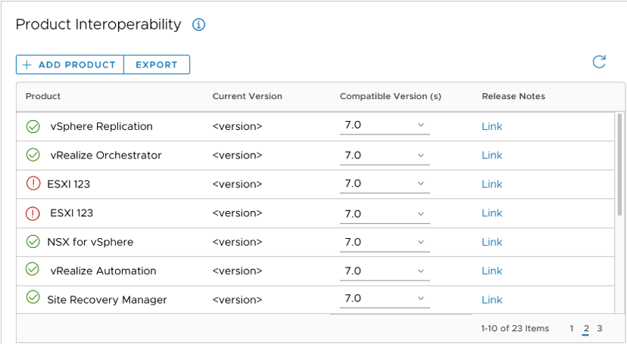
Exporting Report Results
You can export report results in CSV format and use the report as a guide to prepare for an update.
Both product interoperability and precheck reports can be exported.

Slide 12
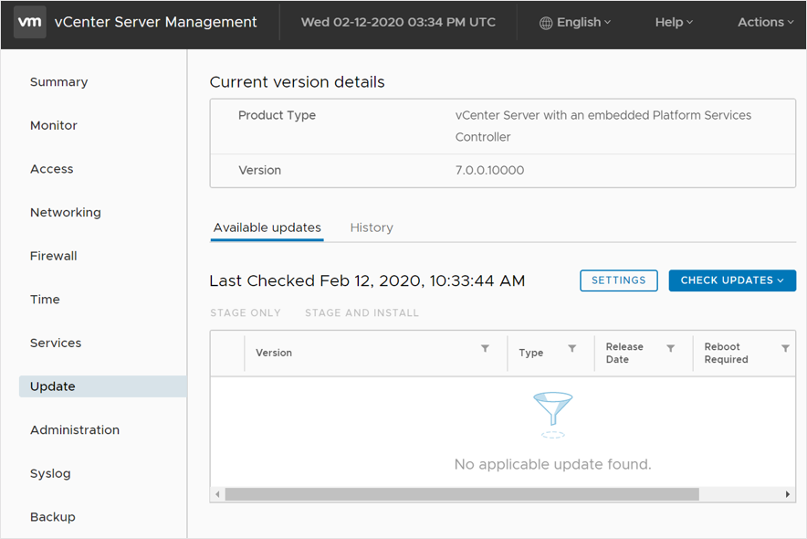
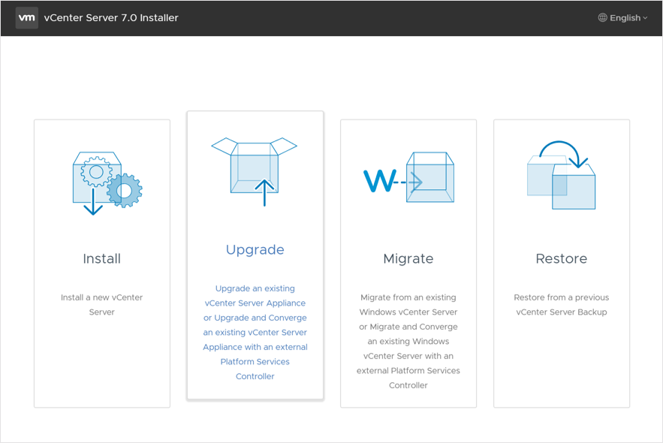
Managing the vCenter Server Life Cycle
To manage the life cycle of vCenter Server, use the vCenter Server Management Interface (VAMI) to update and patch, and use the vCenter Server installer to upgrade.

Slide 13
Review of Learner Objectives
After completing this lesson, you should be able to meet the following objectives:
Describe features of the vCenter Server Update Planner
Run vCenter Server upgrade prechecks and interoperability reports
Export prechecks and interoperability report results

Slide 14
Lesson 2: Overview of vSphere Lifecycle Manager

Slide 15
Learner Objectives
After completing this lesson, you should be able to meet the following objectives:
Recognize features of vSphere Lifecycle Manager
Distinguish between managing hosts using baselines and managing hosts using images
Change the patch download source

Slide 16
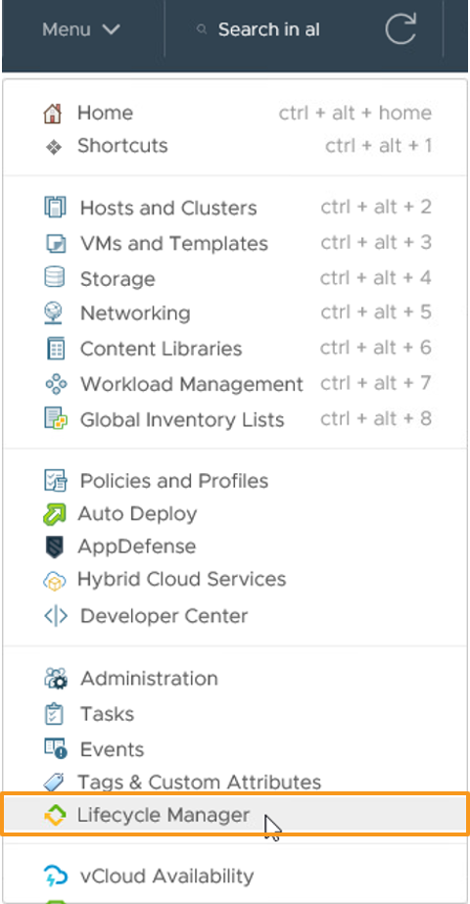
Introduction to vSphere Lifecycle Manager
vSphere Lifecycle Manager centralizes automated patch and version management for clusters, ESXi, drivers and firmware, VM hardware, and VMware Tools.
vSphere Lifecycle Manager features include:
Upgrading and patching ESXi hosts
Installing and updating third-party software on ESXi hosts
Standardizing images across hosts in a cluster
Installing and updating ESXi drivers and firmware
Managing VMware Tools and VM hardware upgrades

Slide 17
Baselines and Images
vSphere Lifecycle Manager supports two methods for updating and upgrading ESXi hosts.
Only one method is supported at a time.
If you switch from managing using baselines to managing using images, you cannot switch back.
Managing Using Baselines | Managing Using Images
Compares ESXi hosts against an ESXi major version, group of patches, or set of extensions. | Compares ESXi hosts against a customized image that includes a base ESXi image, one or more add-on components, one or more vendor add-on components, firmware and drivers.
Supports all versions of ESXi from 6.5 and later. | Supports ESXi version 7.0 and later.
Baselines attach to individual ESXi hosts. | Hosts in a cluster are managed collectively, with one ESXi host image per cluster.
ESXi upgrades through ISO images | ESXi upgrades through image depots (ZIP files).
ESXi updates or patches are bundled into baselines. | ESXi updates or patches are bundled and distributed as new ESXi versions.

Slide 18
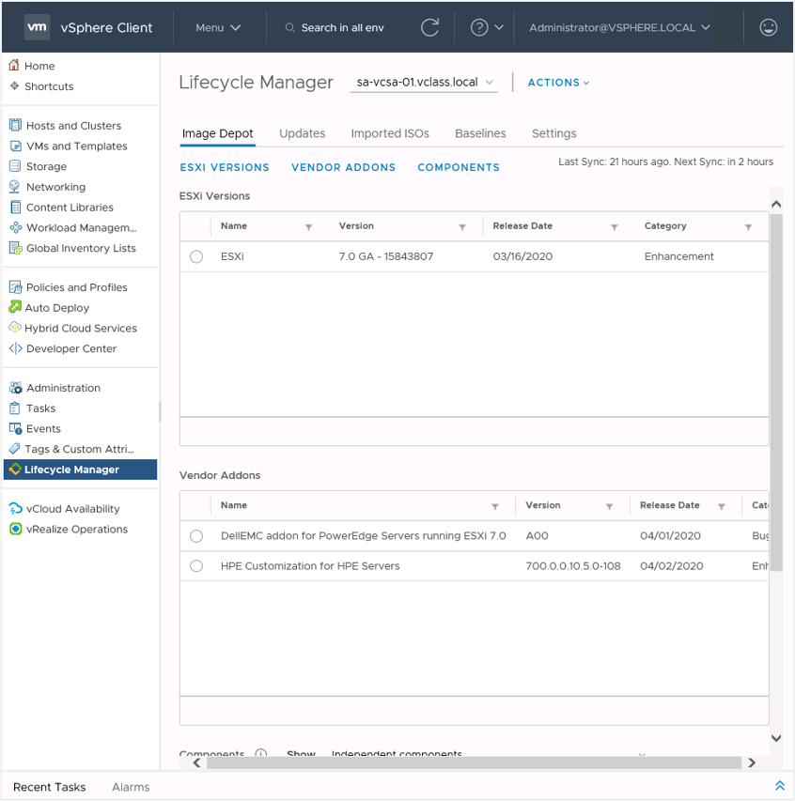
vSphere Lifecycle Manager Home View
In the vSphere Lifecycle Manager home view, you configure and administer the vSphere Lifecycle Manager instance that runs on your vCenter Server system.
From the drop-down menu at the top of the Lifecycle Manager pane, you can select the vCenter Server system that you want to manage.
To access the vSphere Lifecycle Manager home view in the vSphere Client, select Menu > Lifecycle Manager.
Notes:
You do not require special privileges to access the vSphere Lifecycle Manager home view.
In the Lifecycle Manager pane, you can access the following tabs: Image Depot, Updates, Imported ISOs, Baselines, and Settings.

Slide 19
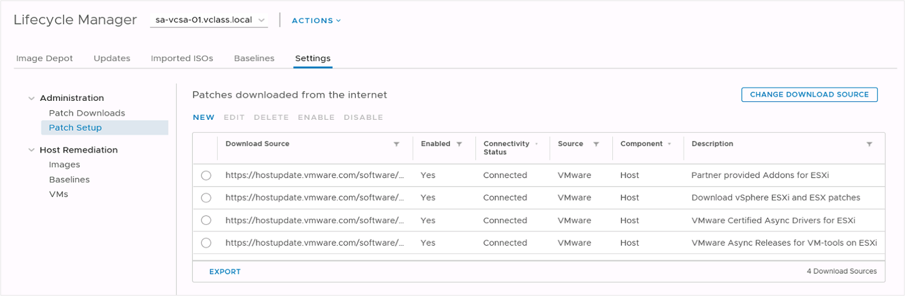
Patch Settings
By default, vSphere Lifecycle Manager is configured to download patch metadata automatically from the VMware repository.
Select Settings > Patch Setup to change the patch download source or add a URL to configure a custom download source.

Slide 20
vSphere Lifecycle Manager Integration with vSphere DRS
When performing remediation operations on a cluster that is enabled with vSphere DRS, vSphere Lifecycle Manager automatically integrates with vSphere DRS:
When vSphere Lifecycle Manager places hosts into maintenance mode, vSphere DRS evacuates each host before the host is patched.
When vSphere Lifecycle Manager attempts to place a host into maintenance mode, certain prechecks are performed to ensure that the ESXi host can enter maintenance mode.
The vSphere Client reports any configuration issues that might prevent an ESXi host from entering maintenance mode.

Slide 21
Review of Learner Objectives
After completing this lesson, you should be able to meet the following objectives:
Recognize features of vSphere Lifecycle Manager
Distinguish between managing hosts using baselines and managing hosts using images
Change the patch download source

Slide 22
Lesson 3: Working with Baselines

Slide 23
Learner Objectives
After completing this lesson, you should be able to meet the following objectives:
Identify types of baselines and baseline groups
Recognize how to create baselines
Describe how to update hosts using baselines

Slide 24
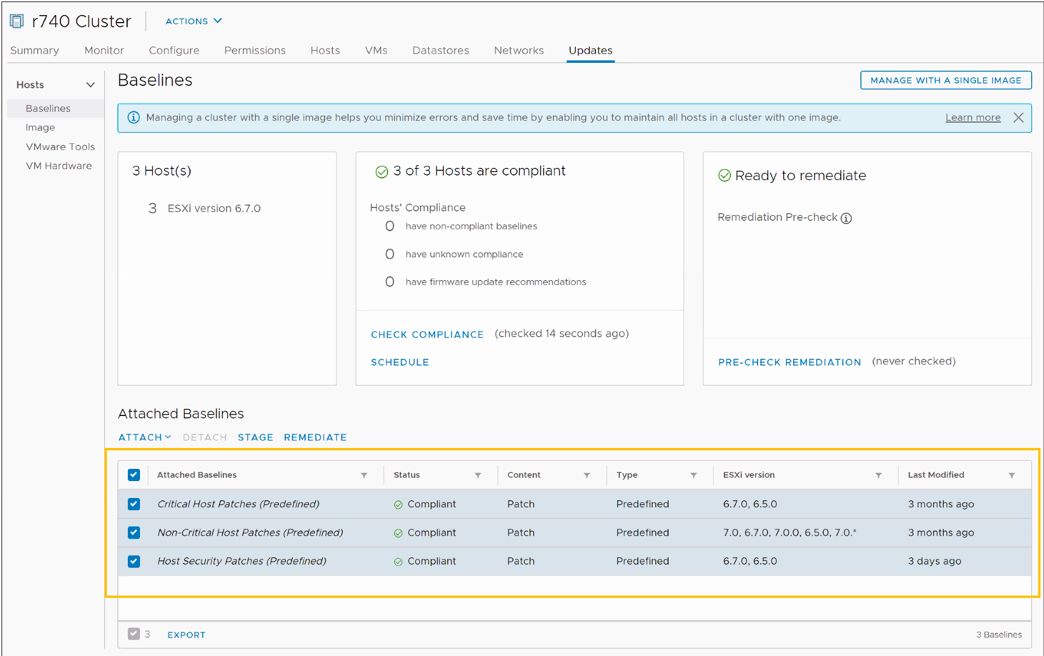
Baselines and Baseline Groups
A baseline includes one or more patches, extensions, or upgrades.
vSphere Lifecycle Manager includes the following dynamic baselines by default:
Critical Host Patches
Non-Critical Host Patches
Host Security Patches
A baseline group includes multiple baselines.
Baseline groups can contain one upgrade baseline and one or more patch and extension baselines.

Slide 25
Creating and Editing Patch or Extension Baselines
Using the New Baseline wizard, you can create baselines to meet the needs of your deployment:
Fixed patch baseline: Set of patches that do not change as patch availability changes.
Dynamic patch baseline: Set of patches that meet certain criteria.
Host extension baseline: Contains additional software for ESXi hosts. This additional software might be VMware or third-party software.
When you create a patch or extension baseline, you can filter the patches and extensions available in the vSphere Lifecycle Manager repository to find specific patches and extensions to include in the baseline.

Slide 26
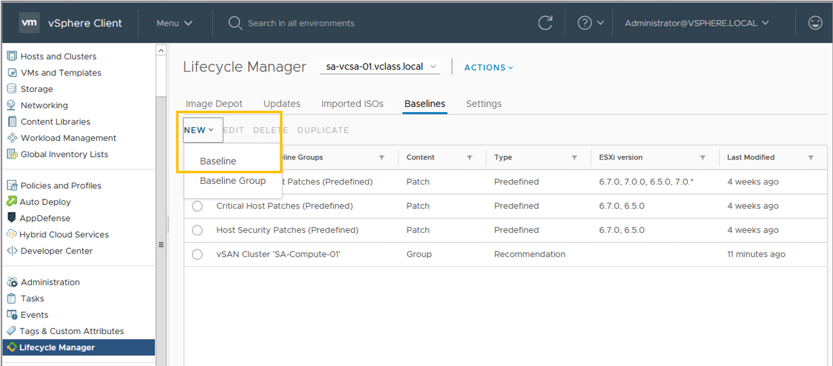
Creating a Baseline
To create a baseline, select Lifecycle Manager from the Menu drop-down menu. Click NEW > Baseline.

Slide 27
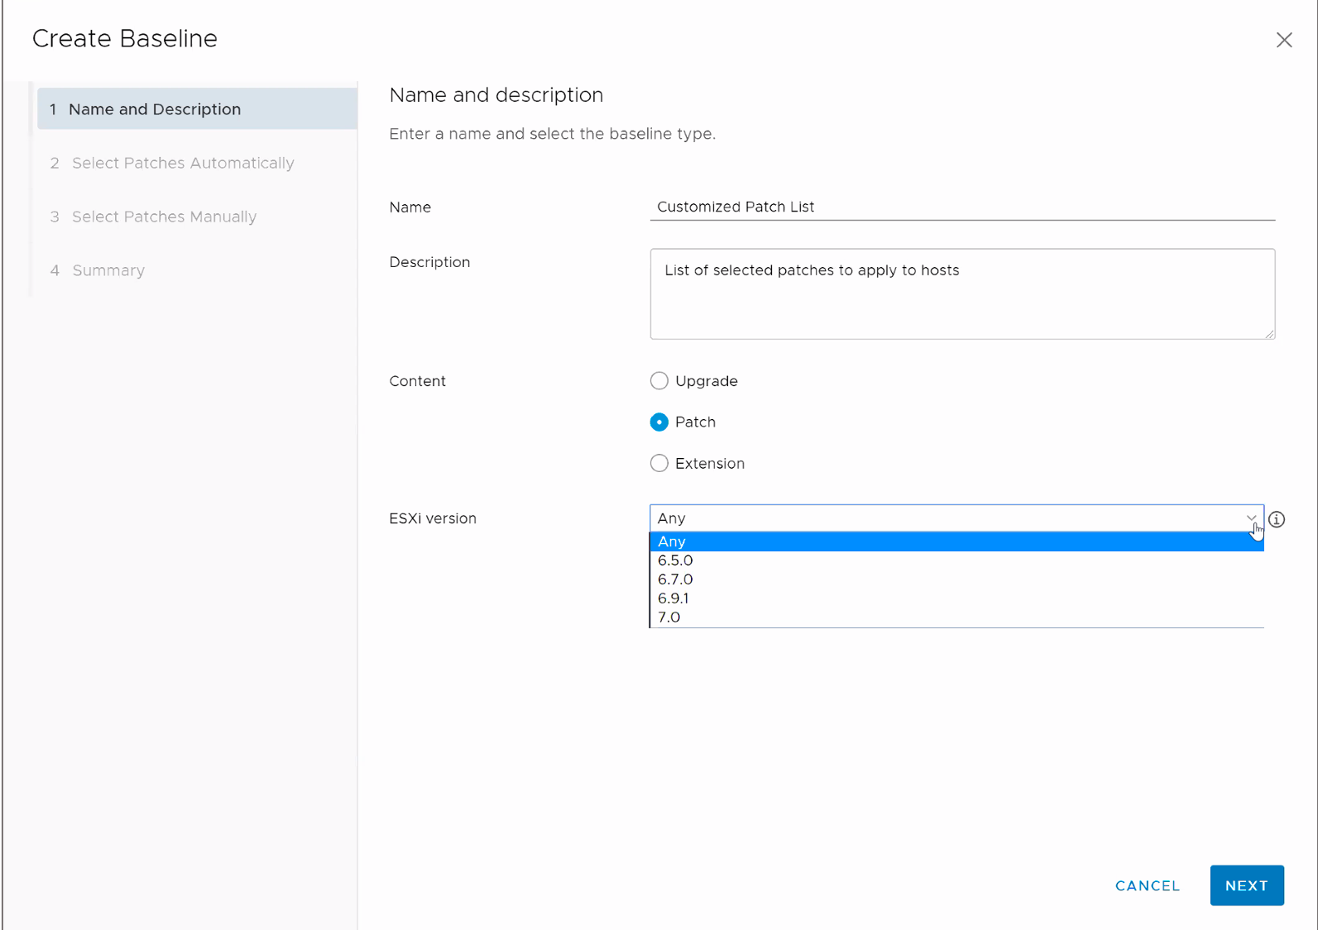
Creating a Baseline: Name and Description
Provide the name, a description, the content of the baseline, and the ESXi version that this baseline applies to.

Slide 28
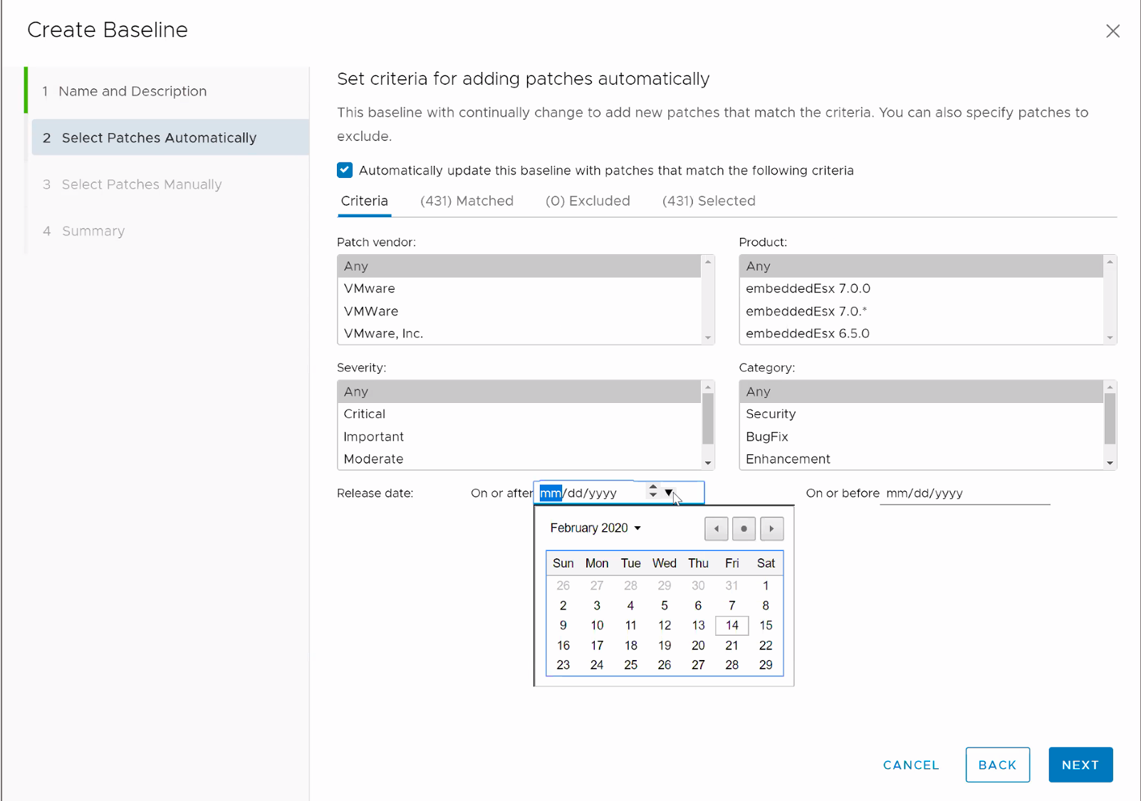
Creating a Baseline: Select Patches Automatically
To create a dynamic baseline, set the criteria for adding patches to the baseline and select the check box for automatic updating of the baseline.
Notes:
A dynamic baseline is a set of patches that meet certain criteria. The content of a dynamic baseline changes as the available patches change. You can manually exclude or add specific patches to the baseline.

Slide 29
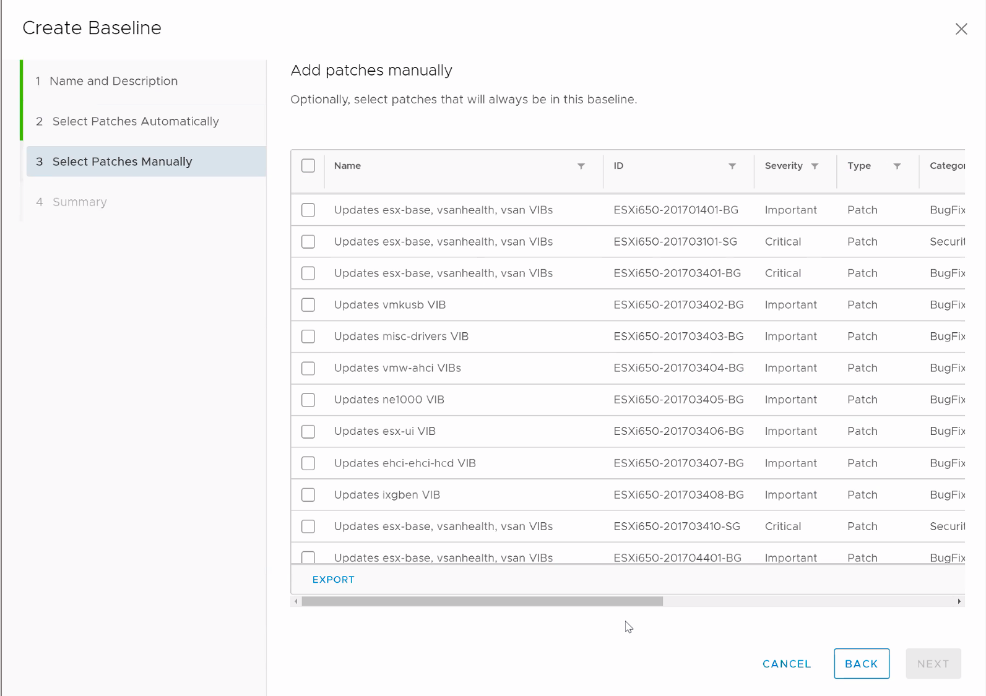
Creating a Baseline: Select Patches Manually
To create a fixed baseline, select the patches that you want to include in the baseline.
You must also disable the automatic updates by deselecting the check box on the Select Patches Automatically page.
Notes:
A fixed baseline is a set of patches that does not change as patch availability changes.

Slide 30
Updating Your Host or Cluster with Baselines
Managing the life cycle of a standalone host or cluster of hosts is a five-step process:
Select your host or cluster and select the Updates tab.
The Baselines window is the default view.
Attach one or more baselines.
Check compliance of your host or cluster with the attached baselines.
Perform a precheck before remediating.
Remediate the host or cluster.
Optionally, stage your patches to copy them to hosts for remediation later.

Slide 31
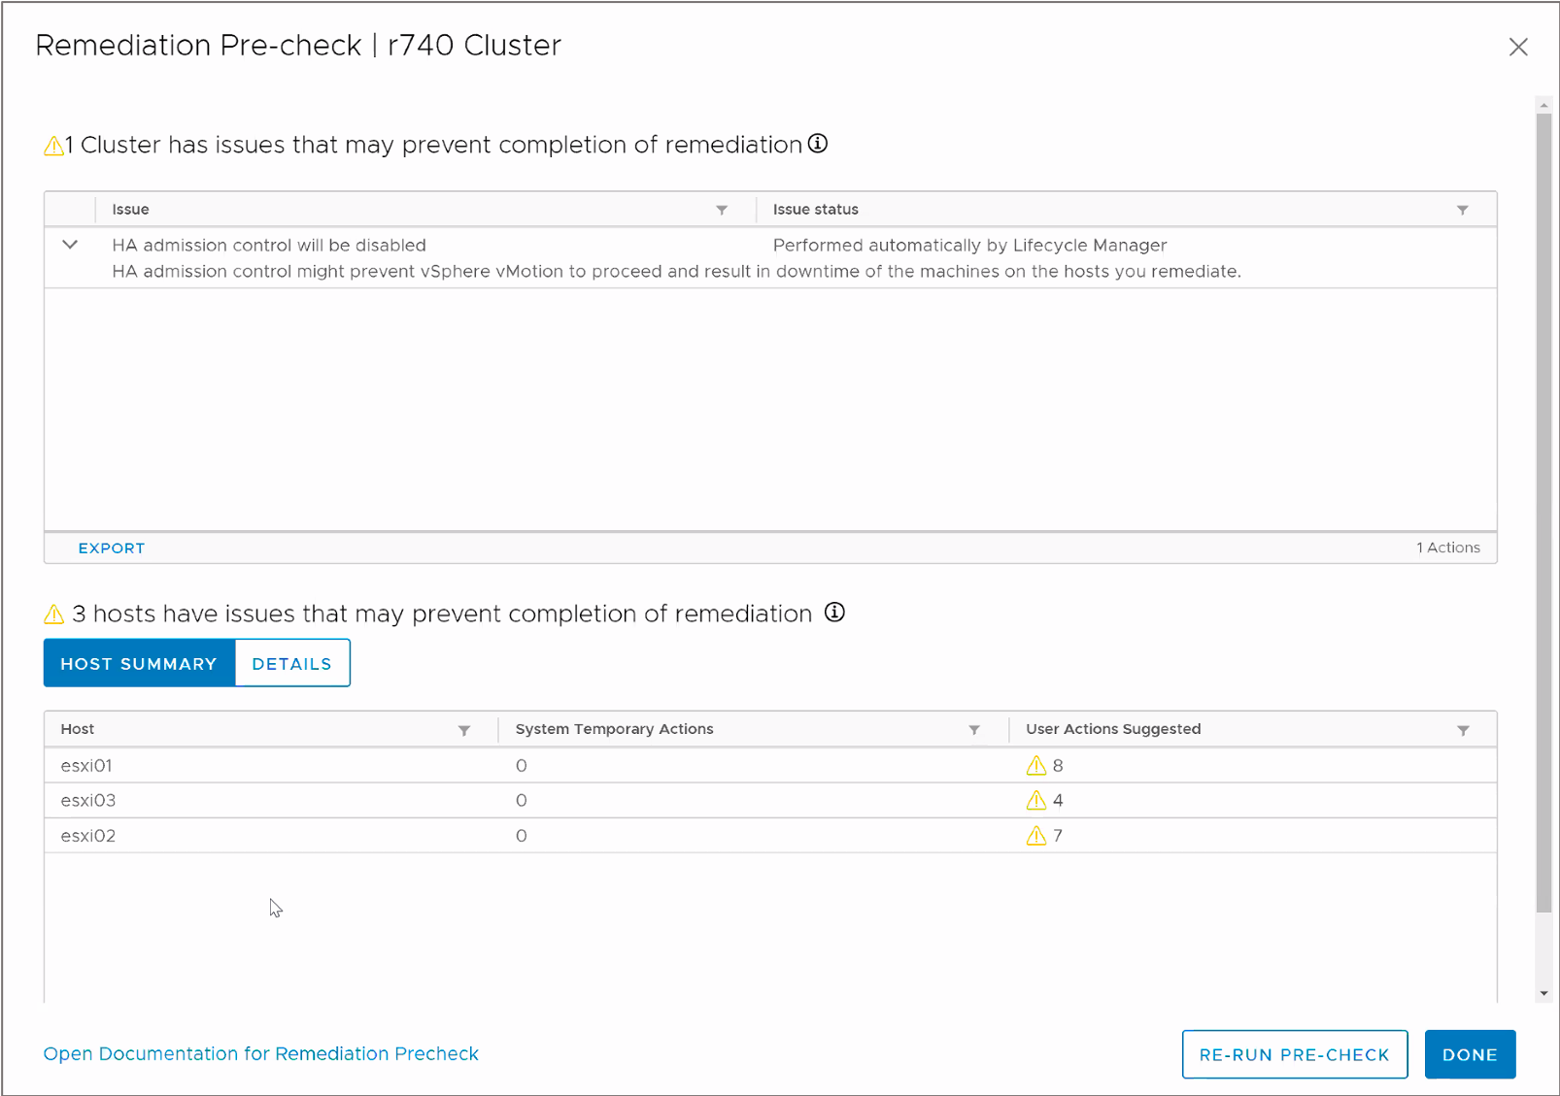
Remediation Precheck
The Remediation Pre-check in vSphere Lifecycle Manager helps to verify that your remediation is successful.
vSphere Lifecycle Manager notifies you about any actions that it takes before the remediation and recommends actions for your attention.

Slide 32
Remediating Hosts
During the remediating process, the upgrades, updates, and patches from the compliance check are applied to your hosts:
You can perform the remediation immediately or schedule it for a later date.
Host remediation runs in different ways, depending on the types of baselines that you attach and whether the host is in a cluster.
For ESXi hosts in a cluster, the process is sequential by default.
The remediation of hosts in a cluster temporarily disables cluster features such as vSphere HA admission control.

Slide 33
Review of Learner Objectives
After completing this lesson, you should be able to meet the following objectives:
Identify types of baselines and baseline groups
Recognize how to create baselines
Describe how to update hosts using baselines

Slide 34
Lesson 4: Working with Images

Slide 35
Learner Objectives
After completing this lesson, you should be able to meet the following objectives:
Describe ESXi images
Import ESXi updates into the vSphere Client
Enable vSphere Lifecycle Manager in a cluster
Define a cluster image using vSphere Lifecycle Manager
Validate ESXi host compliance against a cluster image
Update ESXi hosts using vSphere Lifecycle Manager
Apply a recommended image to the hosts in a cluster

Slide 36
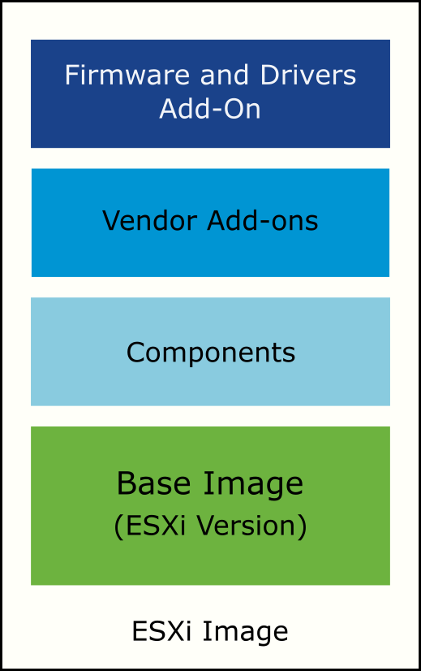
Elements of ESXi Images
Managing clusters with images helps to standardize the software running on your ESXi hosts.
An ESXi image consists of several elements:
ESXi base image: An update that provides software fixes and enhancements
Components: A logical grouping of one or more VIBs (vSphere Installation Bundles) that encapsulates a functionality in ESXi
Vendor add-ons: Sets of components that OEMs bundle together with an ESXi base image
Firmware and Drivers Add-On: Firmware and driver bundles that you can define for your cluster image
To maintain consistency, you apply a single ESXi image to all hosts in a cluster.
Notes:
The ESXi base image is a complete ESXi installation package and is enough to start an ESXi host. Only VMware creates and releases ESXi base images.
The ESXi base image is a grouping of components. You must select at least the base image or vSphere version when creating a cluster image.
Starting with vSphere 7, the component is the smallest unit that is used by vSphere Lifecycle Manager to install VMware and third-party software on ESXi hosts. Components are the basic packaging for VIBs and metadata. The metadata provides the name and version of the component.
On installation, a component provides you with a visible feature. For example, vSphere HA is provided as a component. Components are optional elements to add to a cluster image.
Vendor add-ons are custom OEM images. Each add-on is a collection of components customized for a family of servers. OEMs can add, update, or remove components from a base image to create an add-on. Selecting an add-on is optional.
The firmware and drivers add-on is a vendor-provided add-on. It contains the components that encapsulate firmware and driver update packages for a specific server type. To add a firmware and drivers add-on to your image, you must first install the Hardware Support Manager plug-in for the respective family of servers.

Slide 37
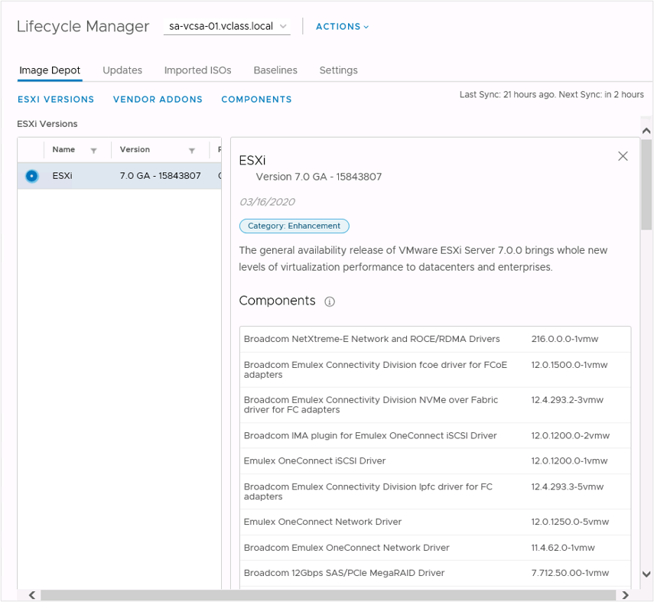
Image Depots
The landing page for the vSphere Lifecycle Manager home view is the Image Depot tab.
In the Image Depot tab, you can view details about downloaded ESXi elements:
ESXi versions
Vendor add-ons
Components
Notes:
When you select a downloaded file, the details appear to the right:
When you select an ESXi version, the details include the version name, build number, category, and description, and the list of components that make up the base image.
When you select a vendor add-on, the details include the add-on name, version, vendor name, release date, category, and the list of added or removed components.
When you select a component, the details include the component name, version, publisher, release date, category, severity, and contents (VIBs).

Slide 38
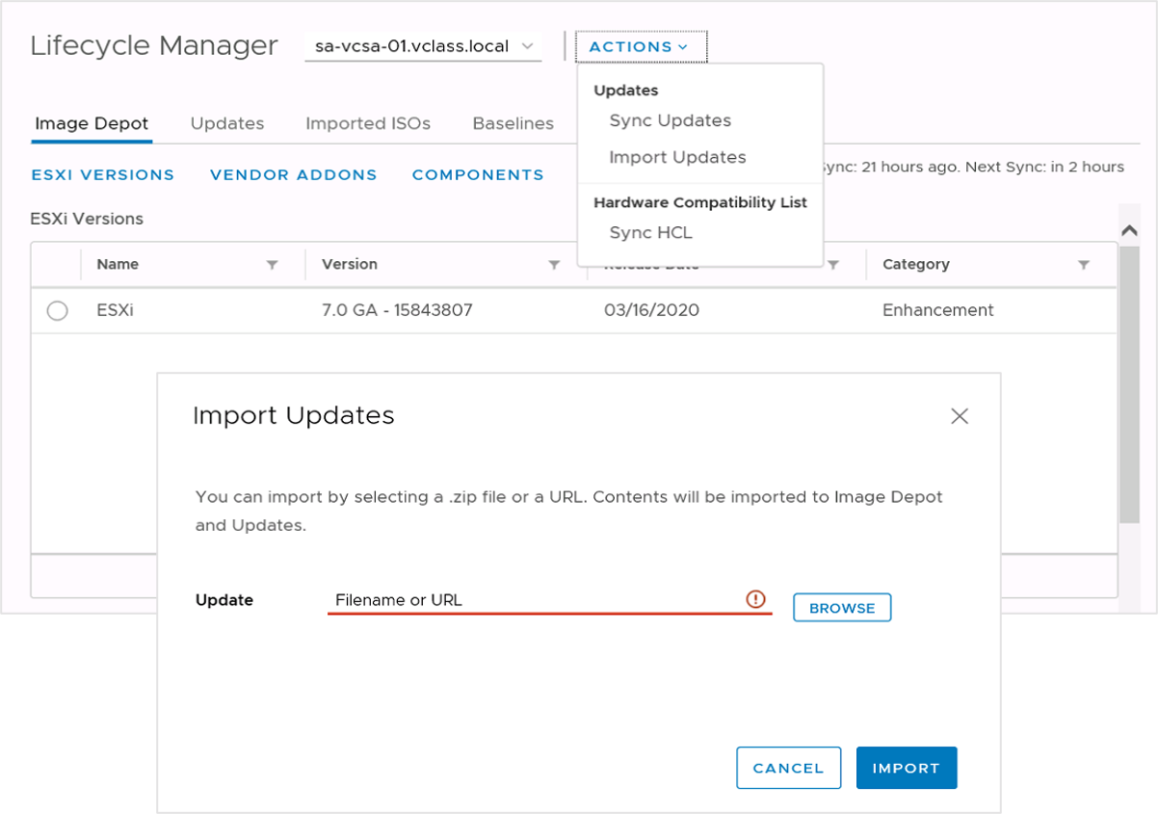
Importing Updates
To use ESXi updates from a configured online depot, select Sync Updates from the Actions drop-down menu in the Lifecycle Manager pane.
You can also use ESXi updates from an offline bundle:
From the Actions drop-down menu, select Import Updates.
Enter a URL or browse for a ZIP file that contains an ESXi image.

Slide 39
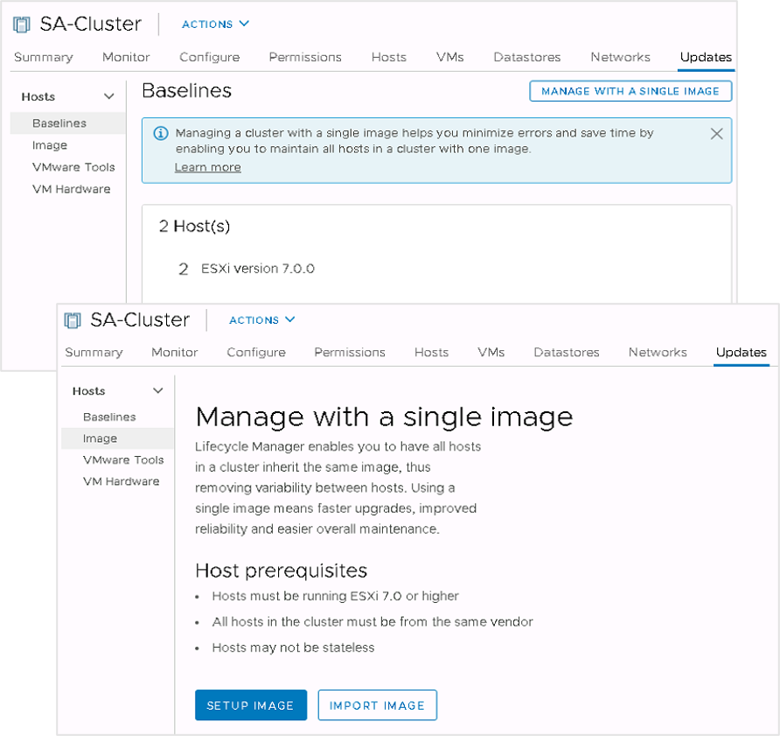
Using Images to Perform ESXi Host Life Cycle Operations
After all ESXi hosts in a cluster are upgraded to vSphere 7, you can convert their lifecycle management from baselines to images.
You set up a single image and apply it to all hosts in a cluster. This step ensures cluster-wide host image homogeneity.
To set up a cluster image, the following requirements apply:
All ESXi hosts must be version 7 or later.
All ESXi hosts must be statefully installed.
Ideally, all physical hosts should be from the same vendor.

Slide 40
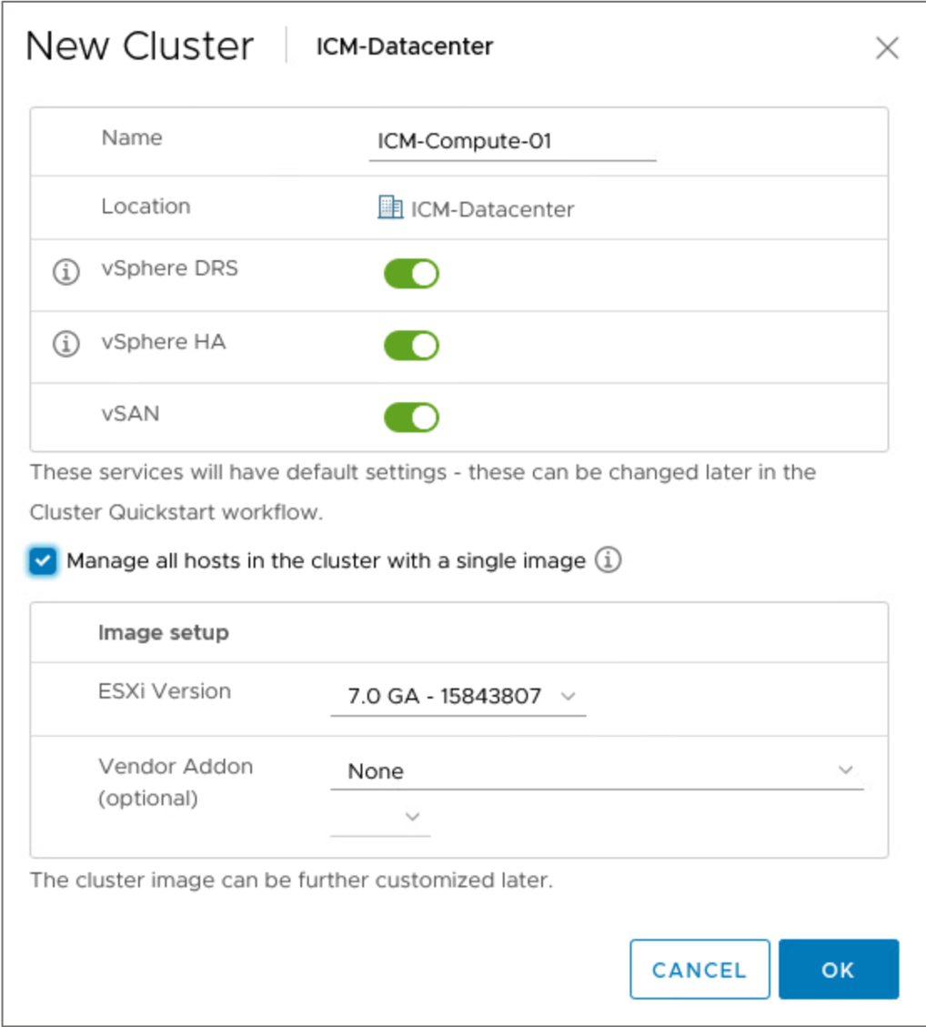
Creating an ESXi Image for a New Cluster
When creating a cluster, you can create a corresponding cluster image:
Create a cluster.
Select the Manage image setup and updates on all hosts collectively check box.
Define the ESXi version for your cluster image.
(Optional) Select vendor add-ons for the host.
Only add-ons that are compatible with the selected vSphere version appear in the drop-down menu.
Notes:
After your cluster is created, add ESXi hosts to it.
The Create New Cluster wizard introduces a switch for enabling vSphere Lifecycle Manager and selecting elements for the desired cluster image.
You can further customize the image in the cluster update settings.

Slide 41
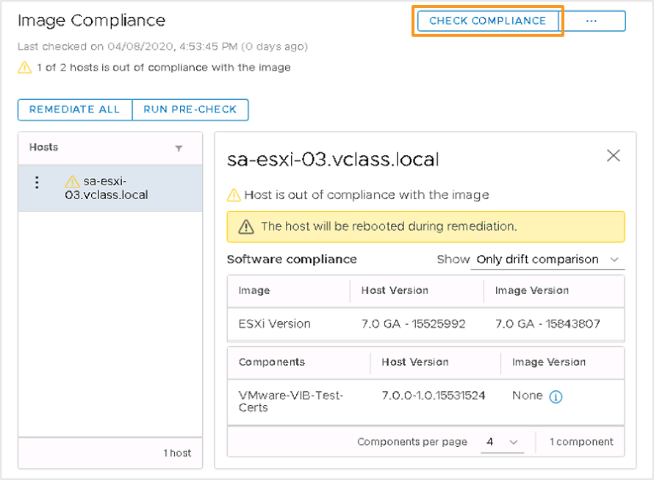
Checking Image Compliance
After you define a valid image, you can perform a compliance check to compare that image with the image that runs on the ESXi hosts in your cluster.
You can check the image compliance at the level of various vCenter Server objects:
At the host level for a specific ESXi host
At the cluster level for all ESXi hosts in the cluster
At the data center level for all clusters and hosts in the data center
At the vCenter Server level for all data centers, clusters, and ESXi hosts in the vCenter Server inventory.
Notes:
The status of a host can be unknown, compliant, out of compliance, or not compatible with the image.
A host status is unknown before you check compliance.
A compliant host is one that has the same ESXi image defined for the cluster and with no standalone VIBs or differing components.
If the host is out of compliance, a message about the impact of remediation appears. In the example, the host must be rebooted as part of the remediation. Another impact that might be reported is the requirement that the host enters maintenance mode.
A host is not compatible if it runs an image version that is later than the desired cluster image version, or if the host does not meet the installation requirements for the vSphere build.

Slide 42
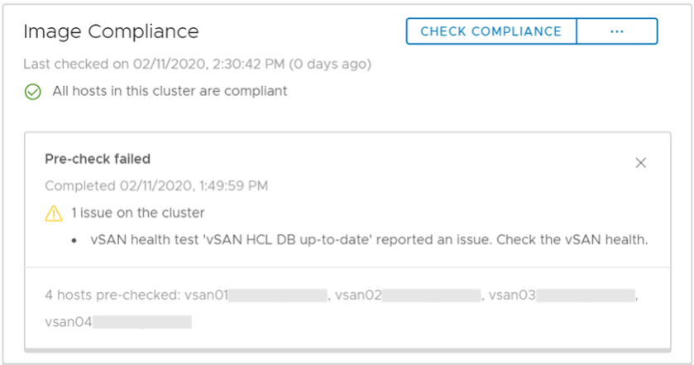
Running a Remediation Precheck
To ensure that the cluster's health is good and that no problems occur during the remediation process of your ESXi hosts, you can perform a remediation precheck.
The procedure for a remediation precheck is as follows:
In the vSphere Client, click Hosts and Clusters and select a cluster that is managed by an image.
In the Updates tab, click Image.
In the Image Compliance pane, run a remediation precheck.

Slide 43
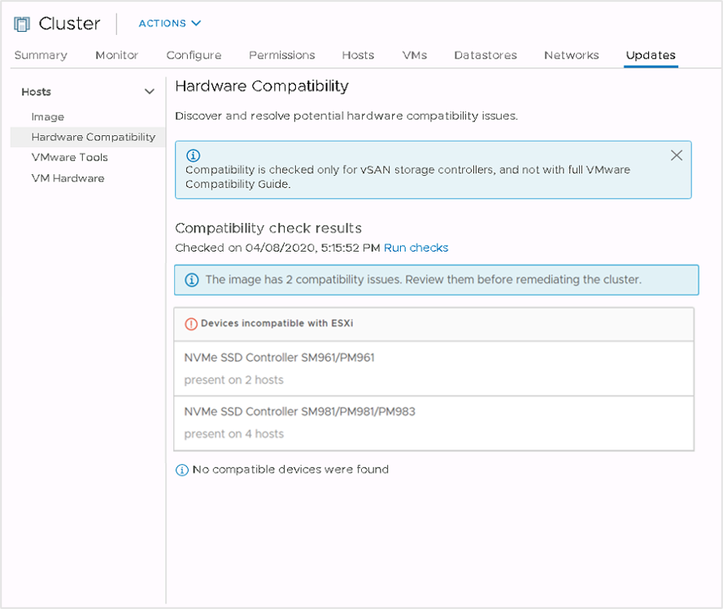
Hardware Compatibility
The hardware compatibility check verifies the underlying hardware of the ESXi host in the cluster against the vSAN Hardware Compatibility List (HCL).
Notes:
Hardware compatibility is checked only for vSAN storage controllers and not with the full VMware Compatibility Guide.

Slide 44
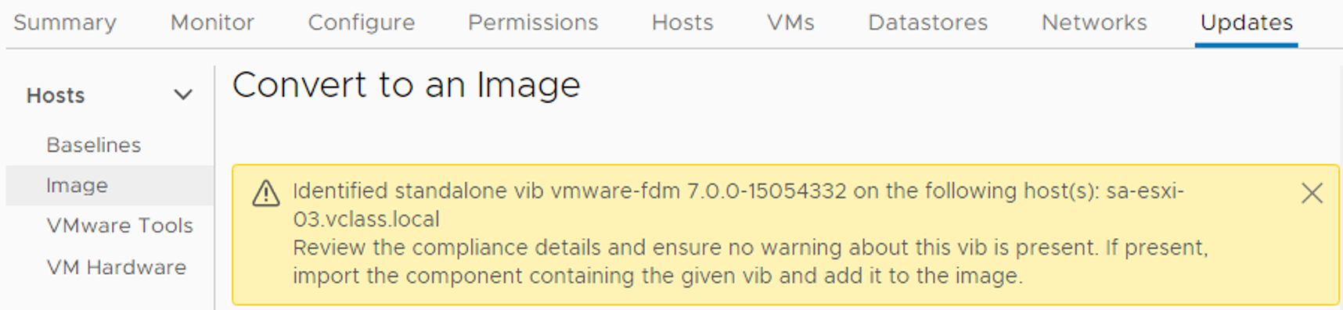
Standalone VIBs
When you convert a cluster to use vSphere Lifecycle Manager, ESXi hosts are scanned.
During this scan, any VIB that is not part of an identified component is identified as standalone, and a warning appears.
Before updating ESXi hosts, you can import or ignore standalone VIBs:
Import a component that contains the VIB and add it to the cluster image.
Ignore the warning and let the update process remove the VIB from the host.
Notes:
A warning about a standalone VIB does not block the process of converting the cluster to use vSphere Lifecycle Manager. If you continue to update ESXi, the VIB is uninstalled from the host as part of the process.
You cannot include standalone VIBs in a cluster image.

Slide 45
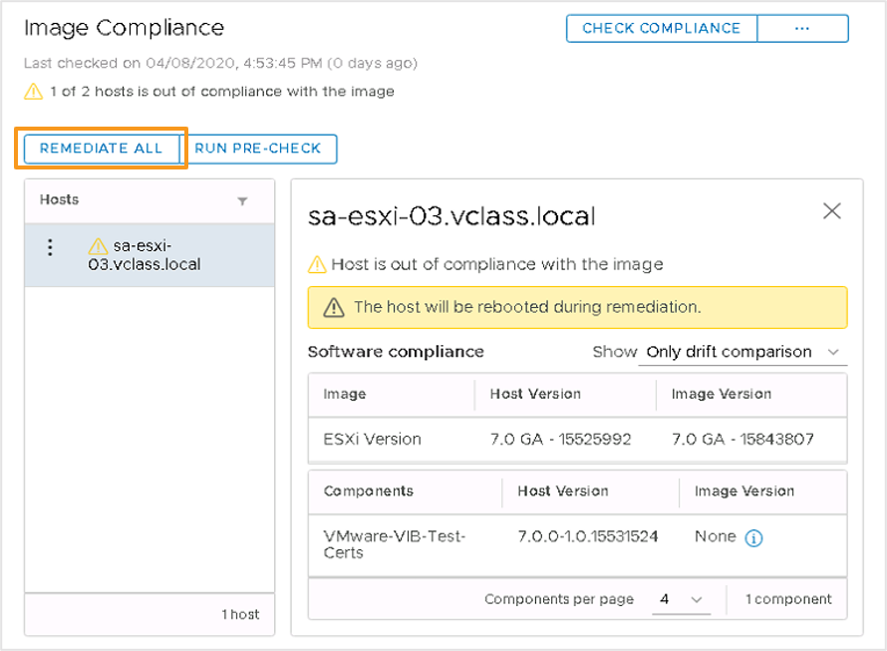
Remediating a Cluster Against an Image
When you remediate a cluster that you manage with an image, vSphere Lifecycle Manager applies the following elements to the ESXi hosts:
ESXi image version
Optional: vendor addon
Optional: firmware and driver addons
Optional: user specified components
Remediation makes the selected hosts compliant with the desired image.
You can remediate a single ESXi host or an entire cluster, or simply pre-check hosts without updating them.
Notes:
The Review Remediation Impact dialog box shows the impact summary, applicable remediation settings, End User License Agreement, and impact on specific hosts.
vSphere Lifecycle Manager performs a precheck on every remediation call. When the precheck is complete, vSphere Lifecycle Manager applies the latest saved cluster image to the hosts.
During each step of a remediation process, vSphere Lifecycle Manager determines the readiness of the host to enter or exit maintenance mode or be rebooted.
You can also click RUN PRE-CHECK to precheck hosts without updating them.

Slide 46
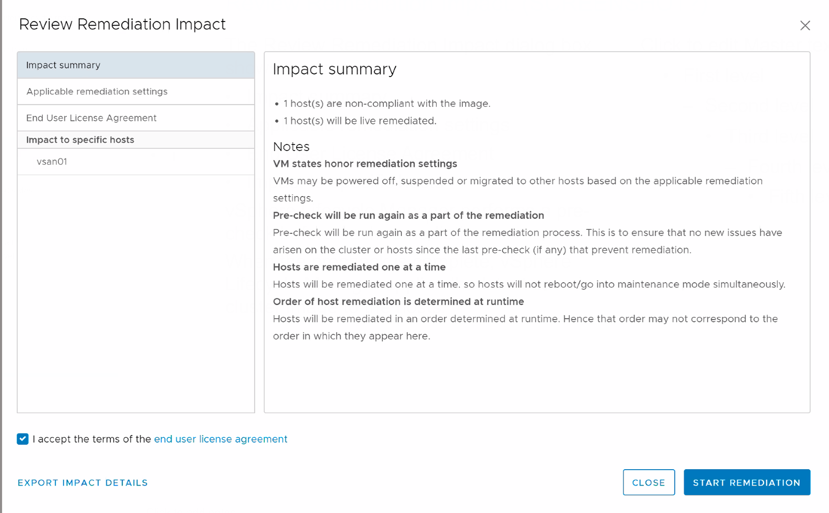
Reviewing Remediation Impact
The Review Remediation Impact dialog box includes the following information:
Impact summary
Applicable remediation settings
End User License Agreement
Impact to specific hosts
vSphere Lifecycle Manager performs a precheck before each remediation.
When the precheck is complete, vSphere Lifecycle Manager applies the latest saved cluster image to the hosts.

Slide 47
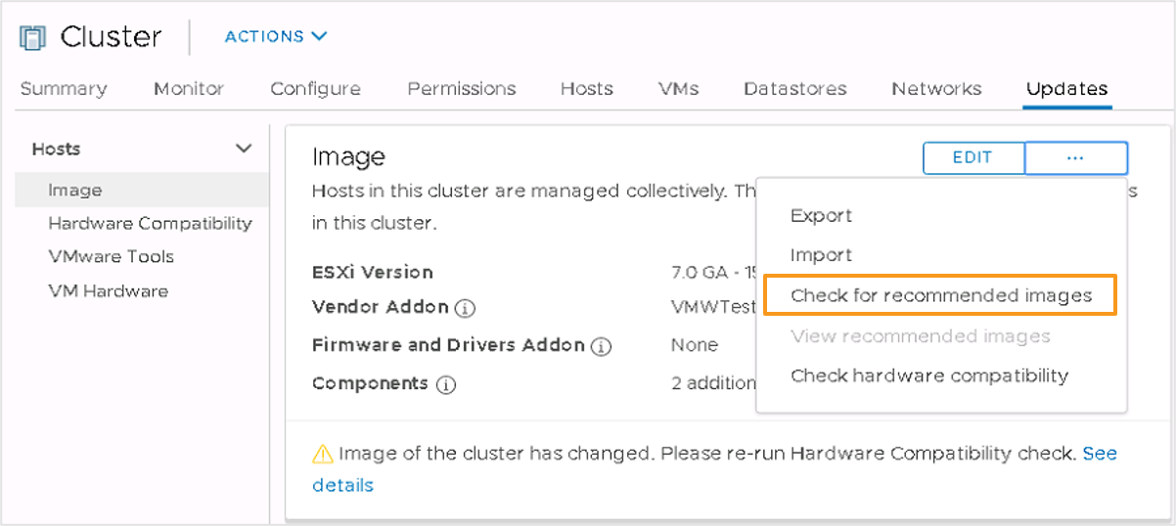
Recommended Images
Using vSphere Lifecycle Manager, you can check for recommended images for a cluster that you manage with an image.
vSphere Lifecycle Manager checks for compatibility across the image components. This process ensures that the recommended image fulfills all software dependencies.
To check for recommended images:
In the Updates tab, select Image in the navigation pane.
Click the ellipses menu next to EDIT and select Check for recommended images.
Notes:
You check for image recommendations on demand and per cluster. You can check for recommendations for different clusters at the same time. When recommendation checks run concurrently with other checks, with compatibility scans, and with remediation operations, the checks are queued to run one at a time.
If you have never checked recommendations for the cluster, the View recommended images option is dimmed.
After you select Check for recommended images, the results for that cluster are generated. The Checking for recommended images task is visible to all user sessions and cannot be canceled. When the check completes, you can select View recommended images.

Slide 48
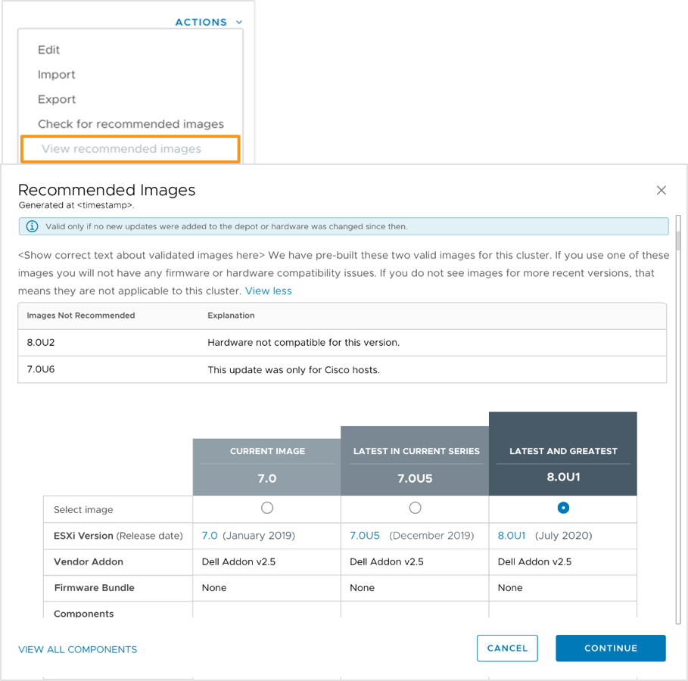
Viewing Recommended Images
To view recommended images for a cluster:
Click the Updates tab for the cluster.
Select Actions under Cluster Image.
Select View recommended images.
Select an image and click CONTINUE.
vSphere shows the recommended images for clusters in the following categories:
Latest release within the current series
Latest major release
Notes:
When you view recommended images, vSphere shows the following types of images:
CURRENT IMAGE: The image specification that is being used to manage the cluster.
LATEST IN CURRENT SERIES: If available, a later version within the same release series appears. For example, if the cluster is running vSphere 7.0 and vSphere 7.1 is released, an image based on vSphere 7.1 appears.
LATEST AND GREATEST: If available, a later version in a later major release. For example, if the cluster is running vSphere 7.0 or 7.1 and vSphere 8.0 is released, an image based on vSphere 8.0 appears.
vSphere might show one or more recommendations:
If the latest release within the current series is the same as the latest major version released, only one recommendation appears.
If the two releases are different, two recommendations appear.
If the current image is the same as the latest release, no recommendations appear.

Slide 49
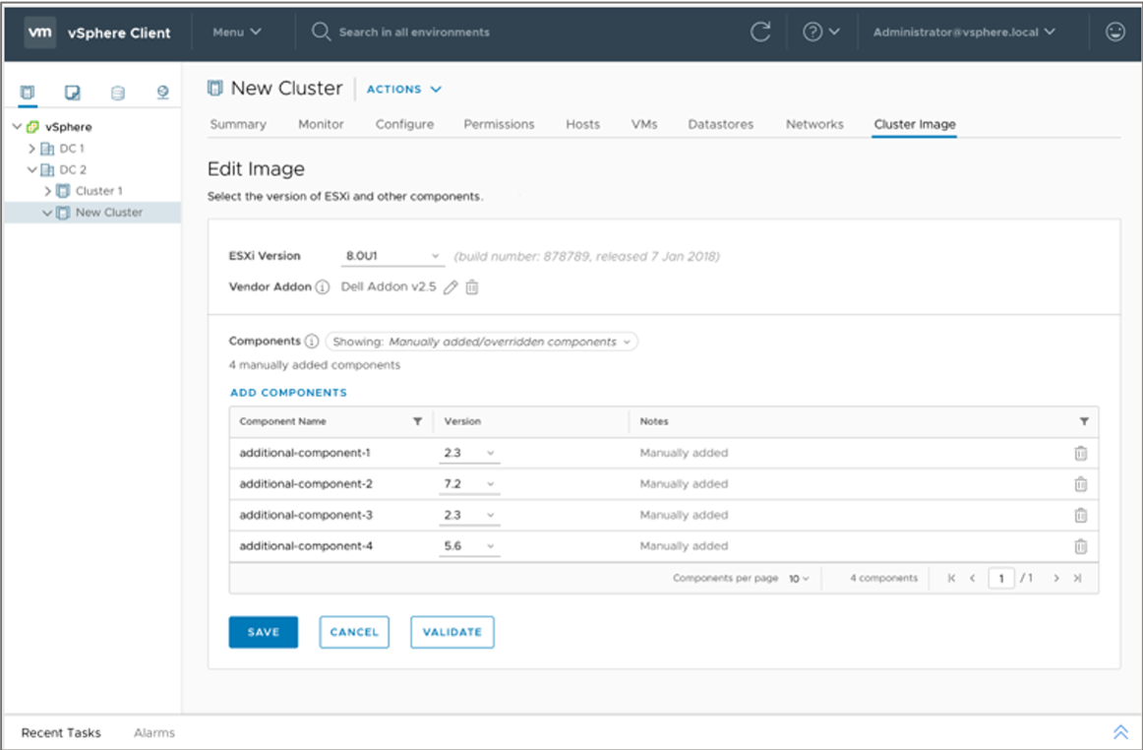
Selecting a Recommended Image
You can select a recommended image and then validate and save it as the desired cluster image.
Notes:
You can use a recommended image as a starting point to customize the cluster image. When you select a recommended image, the Edit Image workflow appears.
You can perform these actions:
Add or remove image components.
Validate and save the image.
Scan the cluster for compatibility.
Remediate the cluster.

Slide 50
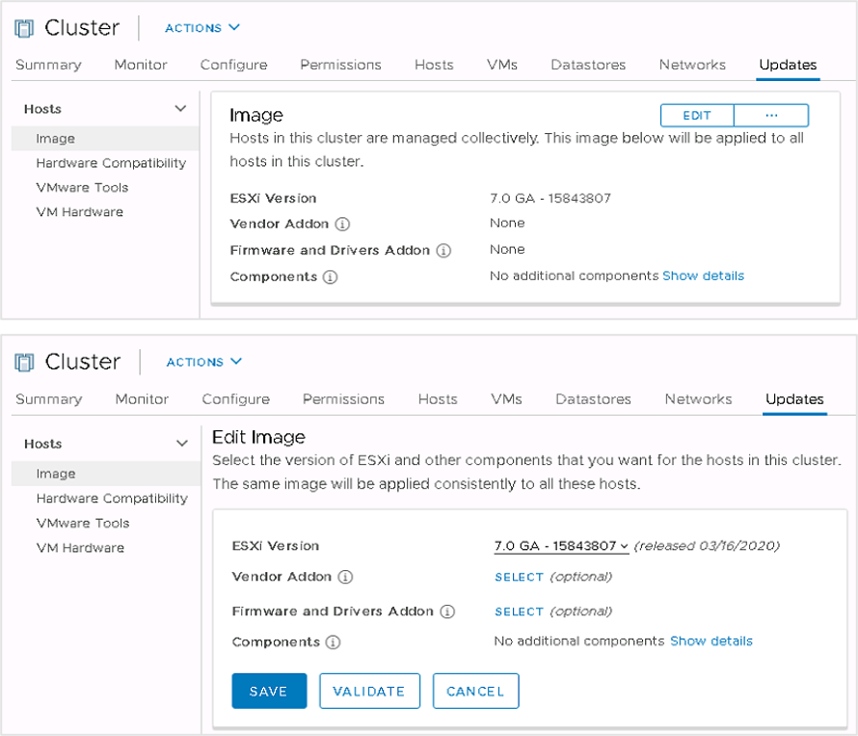
Customizing Cluster Images
After you start managing a cluster with an image, you can edit the image by changing, adding, or removing components, such as the ESXi image version, vendor add-ons, firmware and driver add-ons, and other components.
Before saving the image specification, you can validate it:
Ensures completeness of the image
Verifies that the image has no missing component dependencies
Confirms that components do not conflict with one another

Slide 51
Lab 27: Using vSphere Lifecycle Manager
Update ESXi hosts using vSphere Lifecycle Manager:
Import Update Files to the Image Depot
Create a Cluster with vSphere Lifecycle Manager Enabled
Add ESXi Hosts to the Cluster
Update ESXi Hosts Using the Cluster Image

Slide 52
Review of Learner Objectives
After completing this lesson, you should be able to meet the following objectives:
Describe ESXi images
Import ESXi updates into the vSphere Client
Enable vSphere Lifecycle Manager in a cluster
Define a cluster image using vSphere Lifecycle Manager
Validate ESXi host compliance against a cluster image
Update ESXi hosts using vSphere Lifecycle Manager
Apply a recommended image to the hosts in a cluster

Slide 53
Lesson 5: Managing the Life Cycle of VMware Tools and VM Hardware

Slide 54
Learner Objectives
After completing this lesson, you should be able to meet the following objective:
Use vSphere Lifecycle Manager to upgrade VMware Tools and VM hardware

Slide 55
Keeping VMware Tools Up To Date
With each release of ESXi, VMware provides a new release of VMware Tools.
New releases include:
Bug fixes
Security patches
New driver support for ESXi enhancements
Performance enhancements for virtual devices
Keeping VMware Tools up to date is an important part of ongoing data center maintenance.

Slide 56
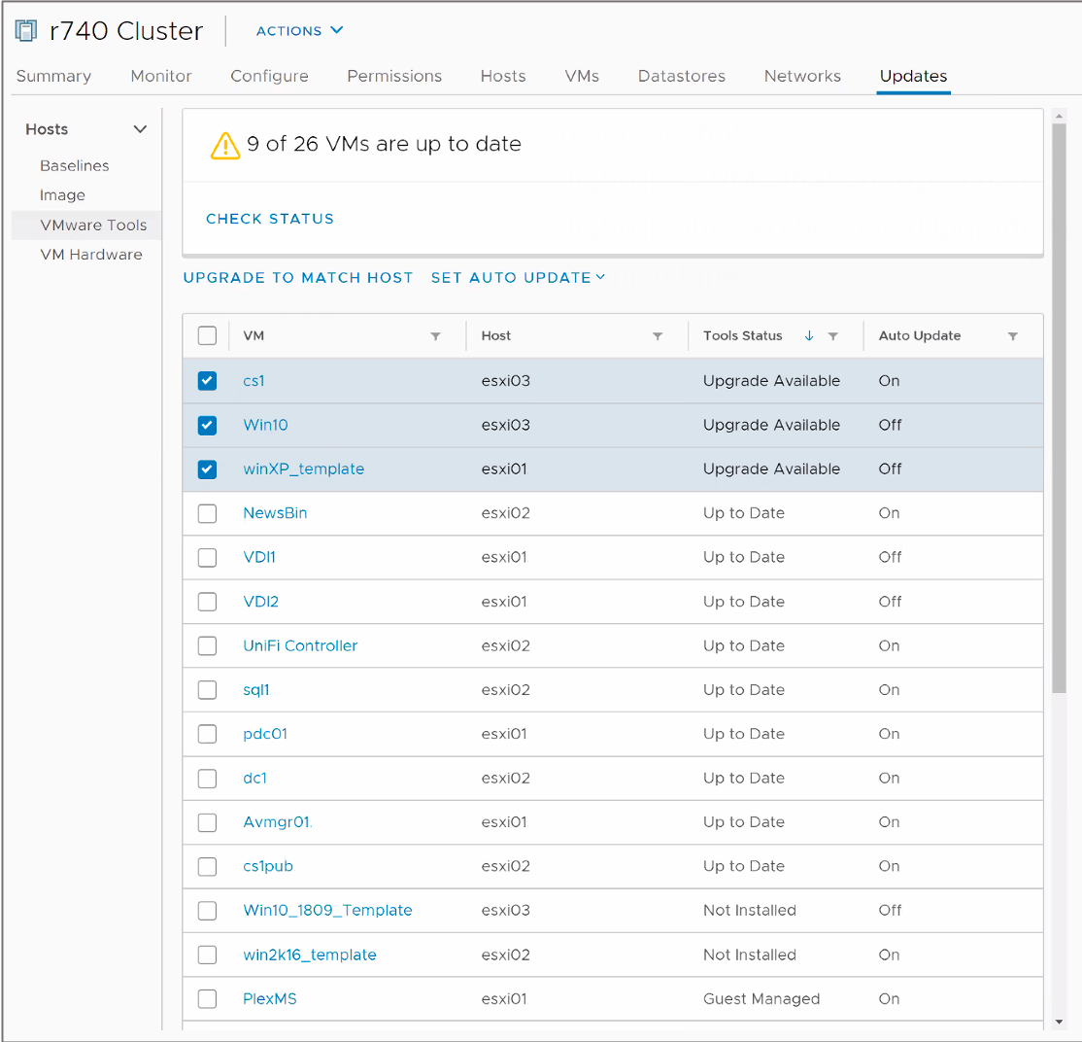
Upgrading VMware Tools (1)
From a host or cluster's Updates tab, select VMware Tools to manage the life cycle of VMware Tools.
Step 1: Check the status of VMware Tools running in your VMs. A VM has one of the following status values:
Upgrade Available
Guest Managed
Not Installed
Unknown
Up to Date
Notes:
A VM has one of the following VMware Tools status values:
Upgrade Available: You can upgrade VMware Tools to match the current version available for your ESXi hosts.
Guest Managed: Your VM is running the Linux OpenVMTools package. Use native Linux package management tools to upgrade VMware Tools.
Not Installed: Consider installing VMware Tools in this VM.
Unknown: vSphere Lifecycle Manager has not yet checked the status of VMware Tools. Ensure that the VM is powered on before clicking the CHECK STATUS link.
Up to Date: The version of VMware Tools running in the VM matches the latest available version for the ESXi host.

Slide 57
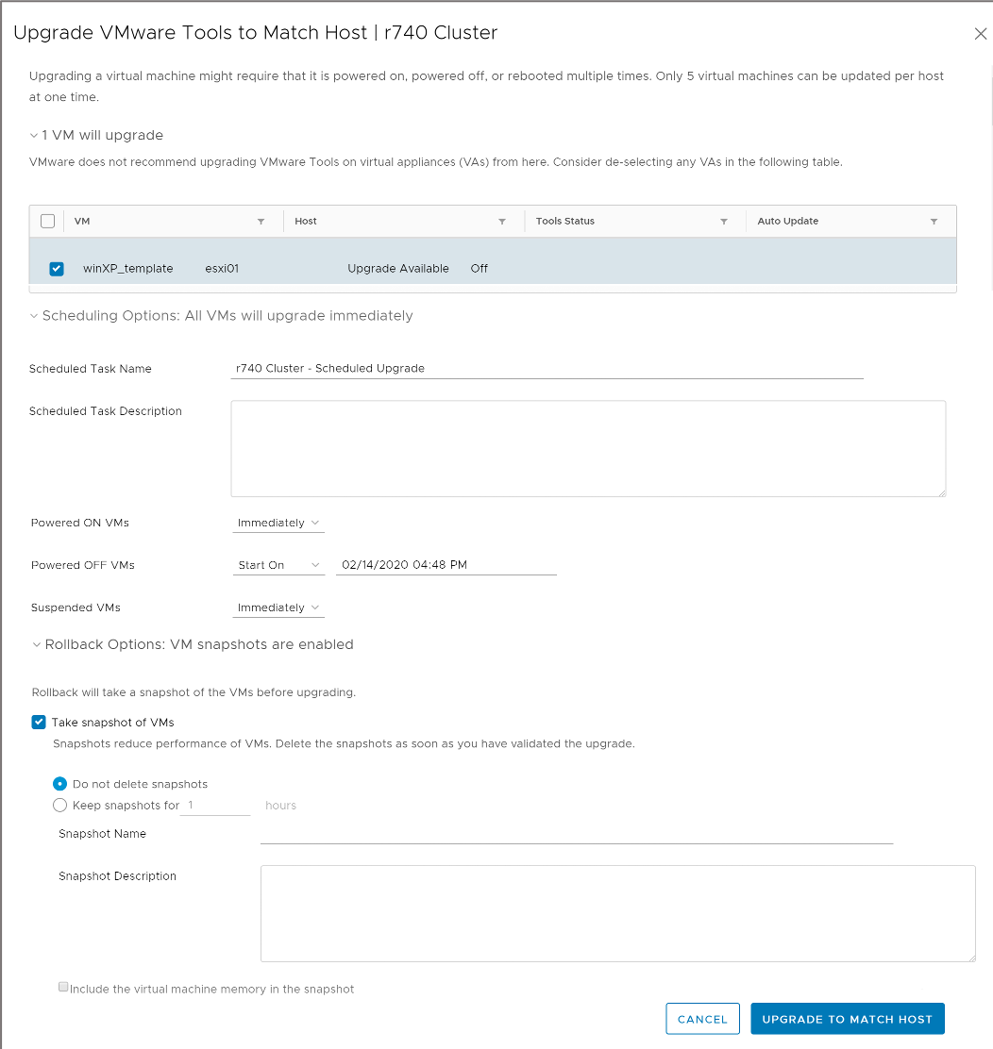
Upgrading VMware Tools (2)
Select the VMs that use VMware Tools whose version you want to upgrade to a newer version.
Step 2: Click UPGRADE TO MATCH HOST.
Select the VMs to upgrade.
Schedule the upgrade.
Plan the upgrade during your maintenance window.
Select rollback options.

Slide 58
Keeping VM Hardware Up To Date
With each subsequent release of ESXi, VMware provides a new release of VM hardware.
As ESXi improves its hardware support, VMware often carries that support into its VMs.
New releases include:
Greater configuration maximums
New types of hardware (for example, vGPU, vNVMe, vSGX, vTPM, and so on)
Consider upgrading VM hardware only when new features are required.

Slide 59
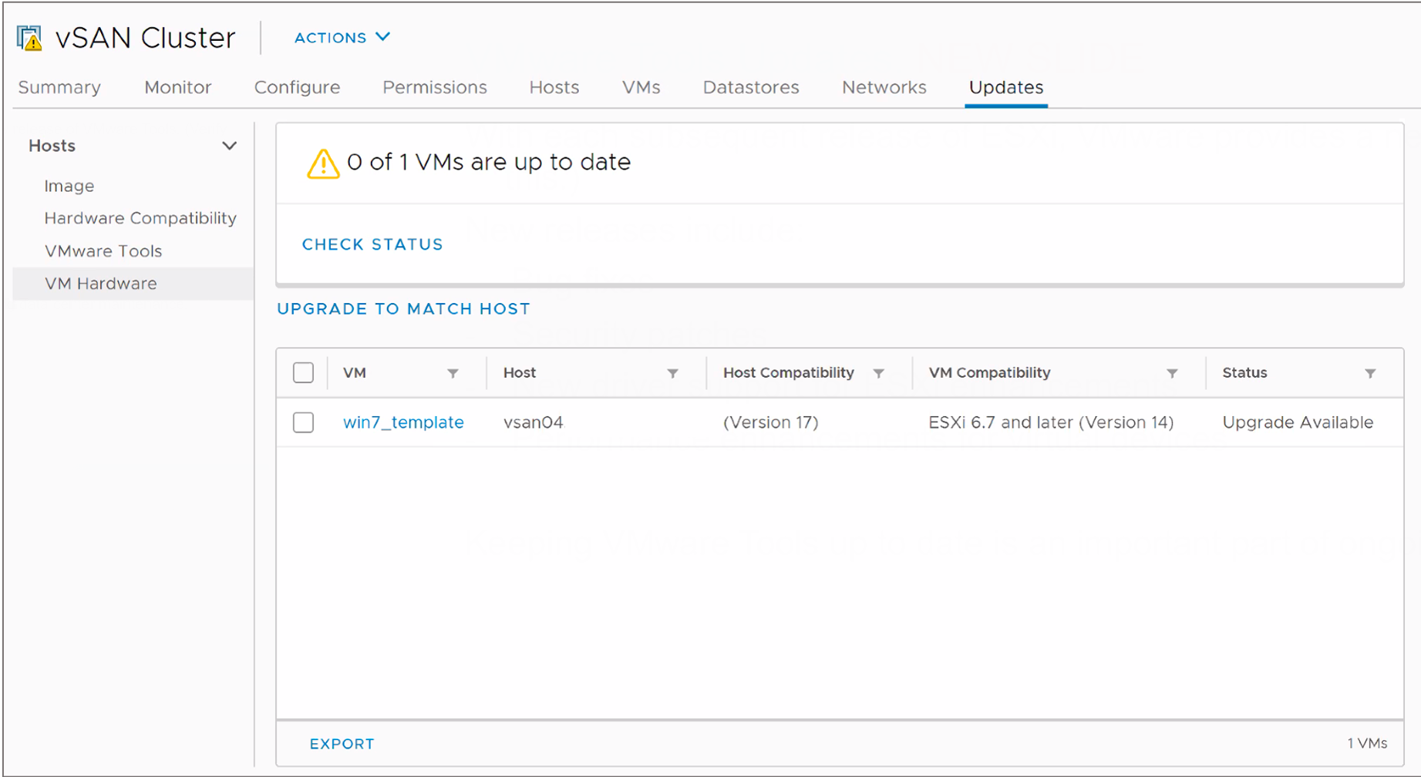
Upgrading VM Hardware (1)
Select VM Hardware to upgrade your VMs' hardware.
Step 1: Check the status of the VM hardware running in your VMs. A VM has one of the following status values:
Upgrade Available: You can choose to upgrade VM hardware to match the current version available for your ESXi hosts.
Up to Date: The version of VM hardware running in the VM matches the latest available version for the ESXi host.

Slide 60
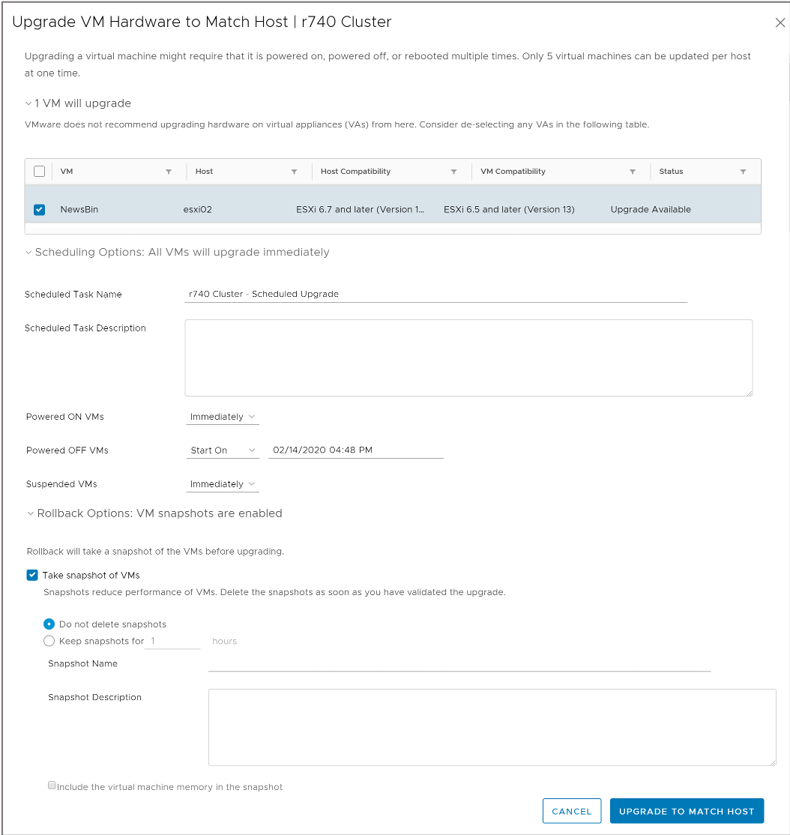
Upgrading VM Hardware (2)
Select the VMs whose hardware version you want to upgrade to the latest version available on the ESXi host on which they run.
Step 2: Click UPGRADE TO MATCH HOST.
Select the VMs to upgrade.
Schedule the upgrade.
Plan the upgrade during your maintenance window.
Select rollback options.

Slide 61
Review of Learner Objectives
After completing this lesson, you should be able to meet the following objective:
Use vSphere Lifecycle Manager to upgrade VMware Tools and VM hardware

Slide 62
Virtual Beans: Conclusion
By developing vSphere knowledge and skills and helping to create a modern data center at Virtual Beans, you help the company meet its expanding business demands.
Your manager recognizes your competence and assigns you as the lead vSphere administrator.
Thinking of the continuous company growth, your manager considers you for cross-training and additional responsibilities.
You think to yourself, “Now I must get that VMware certification!”
VMware Certified Professional - Data Center Virtualization: https://www.vmware.com/education-services/certification/vcp-dcv.html

Slide 63
Key Points
With the Update Planner feature, you can perform prechecks to verify that your vCenter Server system meets the minimum requirements for a successful upgrade.
vSphere Lifecycle Manager centralizes automated patch and version management for clusters, ESXi, drivers and firmware, VM hardware, and VMware Tools.
In vSphere Lifecycle Manager, you can manage ESXi hosts by using baselines, or you can manage a cluster of ESXi hosts by using images.
Keeping VMware Tools up to date is an important part of ongoing data center maintenance.
Consider upgrading VM hardware only when new features are required.
Questions?

